Slide 1
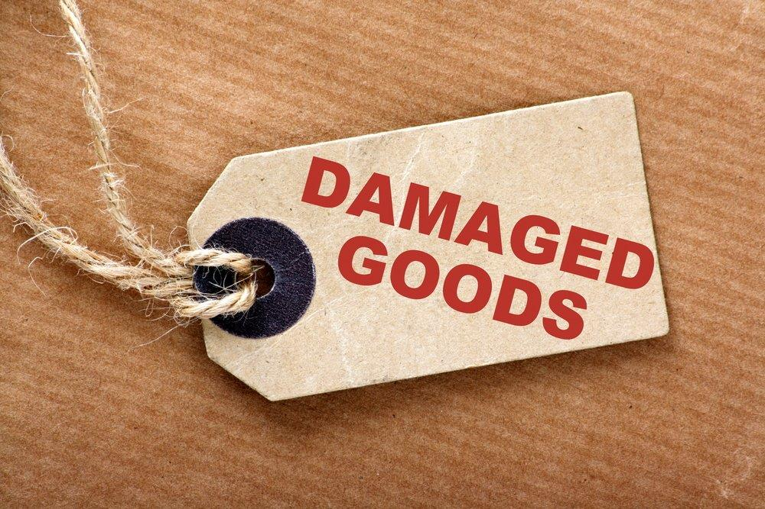

Slide 2
We would love to know more about the people who download our lessons & sermons. We invite you to email us & let us know where & how you use them.
info@ckusa.org

Slide 3
Suggested Next Slide - Song:
“Never Too Broken”
Click or Ctrl Click Here:
https://youtu.be/HCJfal9DBYM

Slide 4
Notes:
When you order something and it comes damaged, what do you do? You reject it and send it back

Slide 5
In the past, you had to fill out a form to get a return authorized.
Often, you were required to pay the shipping costs.
Now, in the age of the Internet, it’s much easier.
Notes:
Used to be, you had to fill out a form of some kind, get a return authorization and sometimes even pay the return shipping costs.
Now in the age of the Internet, it’s much easier:

Slide 6
Send it back!
Notes:
Look familiar?
But there is a another opinion out there, about what to do with damaged goods:
Let’s read about it:

Slide 7
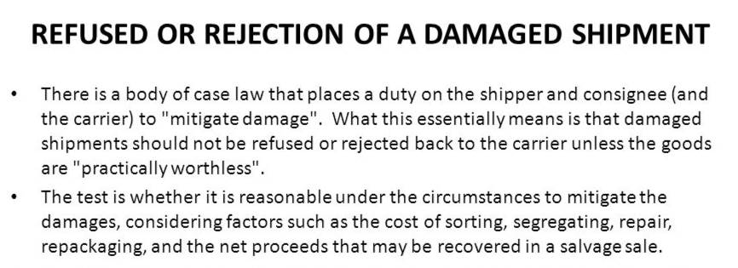
Have YOU ever felt, deep inside, that you were “damaged goods?”
Notes:
NOW, Let’s take a look at what the Bible says about damaged goods:
But a different kind of damaged goods…
Not merchandise – but Mankind,
Not stuff – but Souls,
The apostle Paul told the people of the church at Corinth, (in the book of 1st Corinthians, chapter 1) that no matter how broken their lives had been, no matter how rejected they felt by the society around them, there was a Savior who was going to accept them.

Slide 8
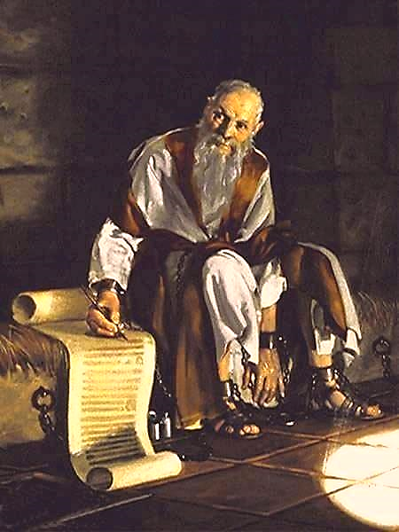
Brothers and sisters, God chose you to be his. Think about that!
Not many of you were wise in the way the world judges wisdom.
Not many of you had great influence, and not many of you came from important families… but…
God chose the foolish things of the world to shame the wise.

Slide 9
He chose the weak things of the world to shame the strong.
And God chose what the world thinks is not important—what the world hates and thinks is nothing.
God did this so that no one can stand before him and boast about anything.

Slide 10
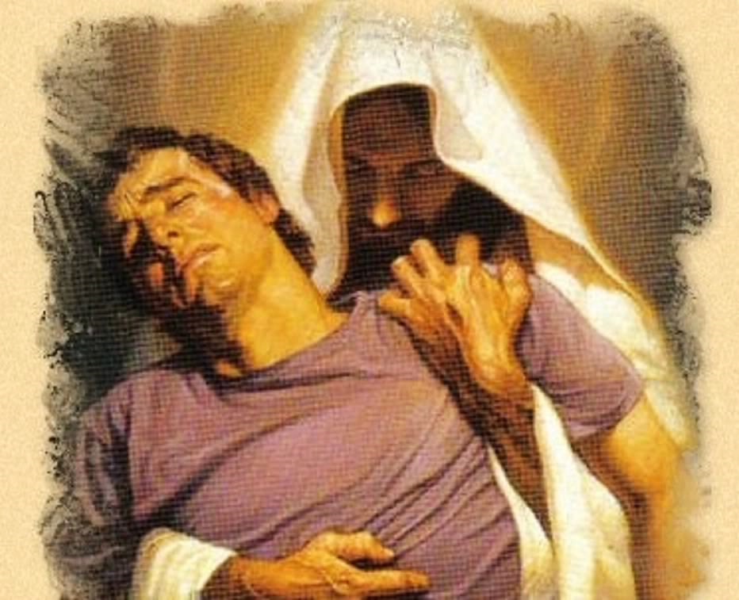
Jesus is in the business of accepting damaged goods
Notes:
I You feel broken, Jesus will still accept you
Listen to a song called, BROKEN THINGS

Slide 11
Suggested Next Slide - Song:
“Broken Things”
Click or Ctrl Click Here:
https://youtu.be/WdUu6ZsdVfM

Slide 12
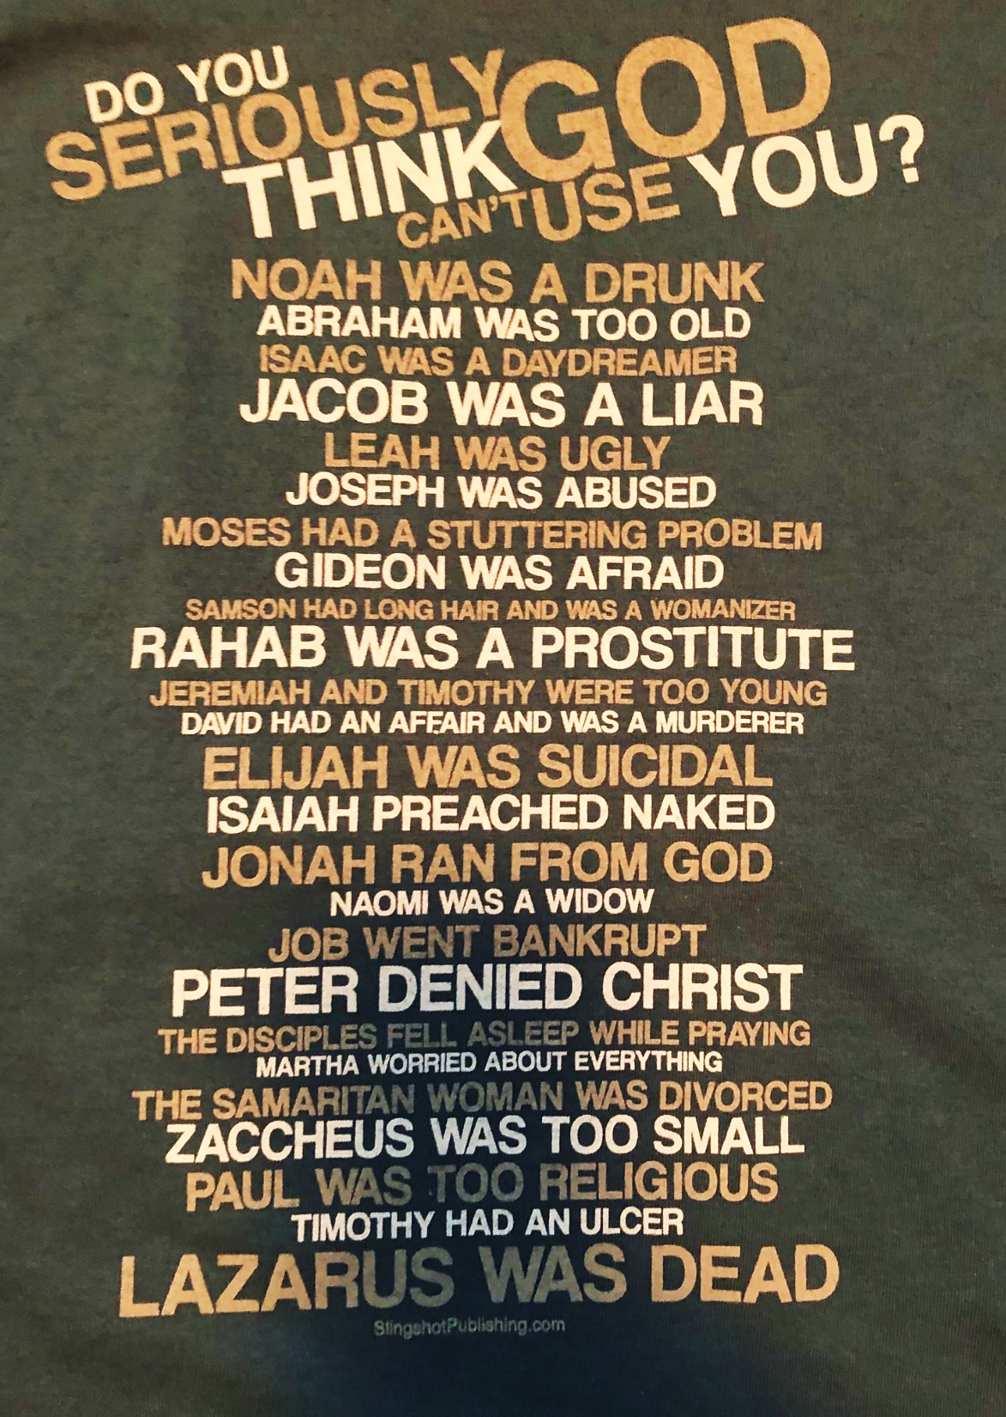
Jesus is in the business of accepting damaged goods!
Notes:
Remember what we read about damaged goods before.? Know this: YOU CAN BE MENDED!

Slide 13
You can be Mended
Jesus is in the business of accepting damaged goods
Notes:
Matthew West wrote a song called “Mended”. Let’s listen to him talk about it before he sings it

Slide 14
Suggested Next Slide - Video:
“Matthew West Testimony Story”
Click or Ctrl Click Here:
https://youtu.be/IgoEEAI0IFU

Slide 15
Suggested Next Slide - Song:
“Mended”
Click or Ctrl Click Here:
https://youtu.be/S7P2vb8zm68

Slide 16
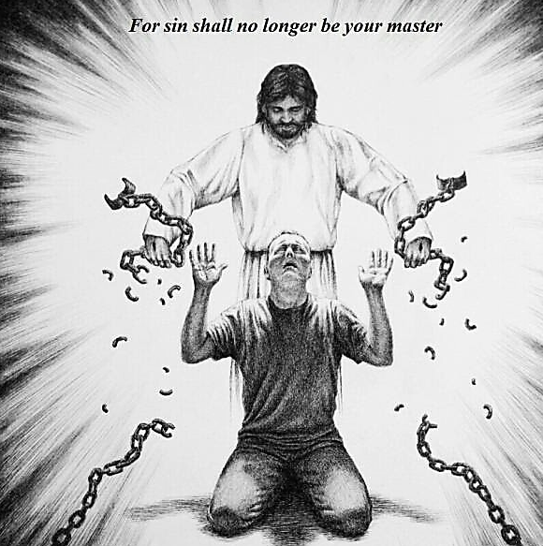
Notes:
What kind of chains do you have? Everybody has chains… Christ can break them ALL… if we turn our lives over to him
Remember: THERE IS POWER IN THE NAME OF JESUS. (Listen with me to this song)

Slide 17
Suggested Next Slide - Video:
“There is Power in the Name of Jesus”
Click or Ctrl Click Here:
https://youtu.be/u531QMmRQxE

Slide 18
Is Jesus
Speaking to You?
“They said to each other, ‘Did not our hearts burn within us while he talked to us on the road, while he opened to us the Scriptures?’”
John Wesley Said:
“…the preacher was describing the change which God works in the heart through faith in Christ and I felt my heart strangely warmed.”
Jesus makes His presence Known by a small voice!

Slide 20
What is the Sinner‘s Prayer?
This is a prayer we can pray when we are ready to admit we are sinners and need Christ’s forgiveness.
It must be prayed with faith in our hearts and a readiness to have a life-changing encounter with Jesus Christ.

Slide 21
“Draw near to God, and He will draw near to you…
…Cleanse your hands, you sinners, and make your hearts pure, you who are half-hearted towards God.” James 4:8 WNT

Slide 22
A prayer of faith → Pray this prayer if :
If you never have before
You have in the past, but you think it would mean more today
You have been walking afar off and you want to come back
You want to set an example & show others how it is done
You just like to give your heart to Jesus again & again
Faith

Slide 23
Dear Jesus,
I know I am a sinner & need your forgiveness.
I believe you died for my sins.
I now turn from sin.
Come into my heart I pray.
Please wash away my sin.
Do you want to meet Jesus as your savior right now?
Do you believe He died to save you from your sins & that He rose from the dead?
Do you believe that He is waiting to save you right now?

Slide 24
“But some people did accept him. They believed in him, and he gave them the right to become children of God.”
John 1:12

Slide 26
We Declare Our Faith Publicly Because Jesus Declared His LOVE Publicly
“If you stand before others and are willing to say you believe in me, then I will tell my Father in heaven that you belong to me.” Mat 10:32

Slide 27
“If you openly say, ‘Jesus is Lord’ and believe in your heart that God raised him from death, you will be saved.”
Rom. 10:9
What did you learn today?
What have you been thinking about God lately?
What do you want to tell others about Jesus?

Slide 28
Close in Prayer

